Slide 1
LLMs as Operating Systems: Agent Memory – A Comprehensive Exploration
Exploring memory, reasoning, and collaboration in AI systems
Notes:
AI-generated content may be incorrect. --- This presentation explores the concept of large language models (LLMs) functioning as operating systems with a focus on agent memory. We will cover foundational concepts, key mechanisms, reasoning and collaboration in multi-agent systems, as well as negotiation, applications, and evolution.

Slide 2
Presentation Agenda
Foundational Concepts of Agent-Based Operating Systems
Key Mechanisms Enabling Agent Functionality
Reasoning and Collaboration in Multi-Agent Systems
Agent Negotiation, Real-World Applications, and Evolution
Notes:
We will begin by examining foundational concepts of agent-based operating systems, then move on to key mechanisms that enable agent functionality. Next, we will discuss reasoning and collaboration in multi-agent systems, and finally explore agent negotiation, real-world applications, and the evolution of agents.

Slide 3
Foundational Concepts of Agent-Based Operating Systems
Notes:
This section introduces the core ideas behind agent-based operating systems, including futuristic OS interfaces, the autonomy of agents, and the dynamics of agent communication, cooperation, and conflict.

Slide 4

Futuristic OS Interfaces and the Role of AI Agents
AI Agents as Primary Interfaces
AI agents serve as the main interface in futuristic OS, providing intelligent and adaptive user interactions.
Autonomous Assistance
AI agents autonomously assist users in complex tasks, improving efficiency and user experience.
Responsive and Context-Aware Systems
Futuristic OS are context-aware, adapting responses based on user environment and needs.
Notes:
--- Futuristic operating systems integrate AI agents as primary interfaces, enabling intelligent and adaptive user experiences. These agents act autonomously to assist users in complex tasks, making systems more responsive and context-aware. Image source: Microsoft 365 content library

Slide 5
Agents as Autonomous Entities: Communication, Cooperation, and Conflict
Autonomous Agent Operation
Agents function independently, making decisions without centralized control to achieve assigned goals effectively.
Communication Among Agents
Agents exchange information to coordinate actions and enhance system performance through effective communication.
Cooperation and Conflict
Agents cooperate to achieve shared objectives but can also have conflicts requiring resolution strategies.
Notes:
--- Agents operate as independent entities that communicate and cooperate to achieve goals, yet they may also experience conflicts. Understanding these interactions is essential for designing effective multi-agent systems. Image source: Microsoft 365 content library

Slide 6

Understanding Agent Conflict and Resolution Strategies
Causes of Agent Conflict
Conflicts arise when agents have competing objectives or compete for limited resources, causing system inefficiencies.
Negotiation Strategy
Negotiation involves agents communicating to reach mutually acceptable agreements to resolve conflicts.
Arbitration and Consensus
Arbitration uses a neutral third party, while consensus-building ensures agreement among all agents to maintain harmony.
Notes:
--- Conflicts among agents can arise due to competing objectives or resource contention. Resolution strategies include negotiation, arbitration, and consensus-building to maintain system harmony. Image source: Microsoft 365 content library

Slide 7
Key Mechanisms Enabling Agent Functionality
Notes:
This section covers mechanisms that empower agents to function effectively, focusing on context, state tracking, communication protocols, and efficient memory management.

Slide 8

The Importance of Context in Agent Decision-Making
Role of Context
Context offers environmental and historical data essential for agents to understand situations accurately.
Informed Decision-Making
Agents use context to make informed choices that adapt to changing environments effectively.
Alignment with Goals
Context helps ensure decisions align with overall system goals and desired outcomes.
Notes:
--- Context provides agents with relevant environmental and historical information, allowing them to make informed and adaptive decisions aligned with system goals. Image source: Microsoft 365 content library

Slide 9

Tracking State with Shared Variables Across Agents
Consistent State Maintenance
Shared variables ensure all agents have access to the same state information, maintaining consistency.
Agent Coordination
Shared variables enable agents to coordinate their actions effectively in changing environments.
Dynamic Environment Adaptation
Maintaining shared variables supports agents adapting to dynamic and evolving situations simultaneously.
Notes:
--- Shared variables help maintain a consistent state across multiple agents, facilitating coordination and synchronized actions in dynamic environments. Image source: Microsoft 365 content library

Slide 10

Communication Protocols for Effective Agent Interaction
Reliable Information Exchange
Communication protocols ensure agents exchange data consistently and without errors.
Efficient Communication
Protocols streamline message transmission to optimize agent interaction speed and resource use.
Supporting Cooperation
Effective protocols help agents collaborate seamlessly to achieve shared goals.
Conflict Resolution
Protocols facilitate resolving conflicts by enabling clear and structured interactions.
Notes:
--- Robust communication protocols enable agents to exchange information reliably and efficiently, supporting cooperation and conflict resolution. Image source: Microsoft 365 content library

Slide 11

Memory Management: Storing and Recalling Information Efficiently
Importance of Memory Management
Efficient memory management enables agents to quickly access stored knowledge, enhancing decision-making accuracy.
Storing Knowledge
Agents must effectively store relevant data to build a comprehensive knowledge base for future use.
Recalling Information
Timely and accurate recall of information is essential for learning and optimizing agent responses.
Notes:
--- Efficient memory management is critical for agents to store knowledge and recall information when needed, optimizing decision-making and learning processes. Image source: Microsoft 365 content library

Slide 12
Reasoning and Collaboration in Multi-Agent Systems
Notes:
We explore how agents reason under uncertainty, collaborate by sharing resources, and coordinate their actions to achieve complex objectives.

Slide 13

Partial Observability and Inference in Uncertain Environments
Incomplete Information Challenge
Agents must make decisions despite not having full knowledge of their surroundings or other agents' conditions.
Inference Techniques
Inference methods enable agents to predict hidden states and adapt their actions effectively in uncertain scenarios.
Notes:
--- Agents often operate with incomplete information, requiring inference techniques to make educated guesses about the environment and other agents' states. Image source: Microsoft 365 content library

Slide 14

Inference Techniques for Agent Reasoning Under Uncertainty
Probabilistic Reasoning
Probabilistic reasoning allows agents to make decisions based on likelihoods and uncertainties in complex environments.
Bayesian Networks
Bayesian networks represent dependencies among variables to update beliefs with new evidence efficiently.
Heuristic Approaches
Heuristics provide practical methods for agents to infer solutions when exact reasoning is computationally expensive.
Notes:
--- Techniques such as probabilistic reasoning, Bayesian networks, and heuristic approaches help agents reason effectively despite uncertainty. Image source: Microsoft 365 content library

Slide 15

Collaboration: Sharing Resources, Coordinating, and Learning Together
Sharing Information and Resources
Effective collaboration requires sharing information and resources among agents to achieve common goals efficiently.
Coordinating Actions
Coordinated actions ensure that efforts are aligned and tasks are executed smoothly within the collaborative system.
Collective Learning
Agents learn together from shared experiences to continuously improve collective system performance.
Notes:
--- Collaboration involves agents sharing information and resources, coordinating actions, and collectively learning to improve system performance. Image source: Microsoft 365 content library

Slide 16
Agent Negotiation, Real-World Applications, and Evolution
Notes:
This final section addresses how agents negotiate, practical applications of multi-agent systems, and how agents evolve through learning and adaptation.

Slide 17
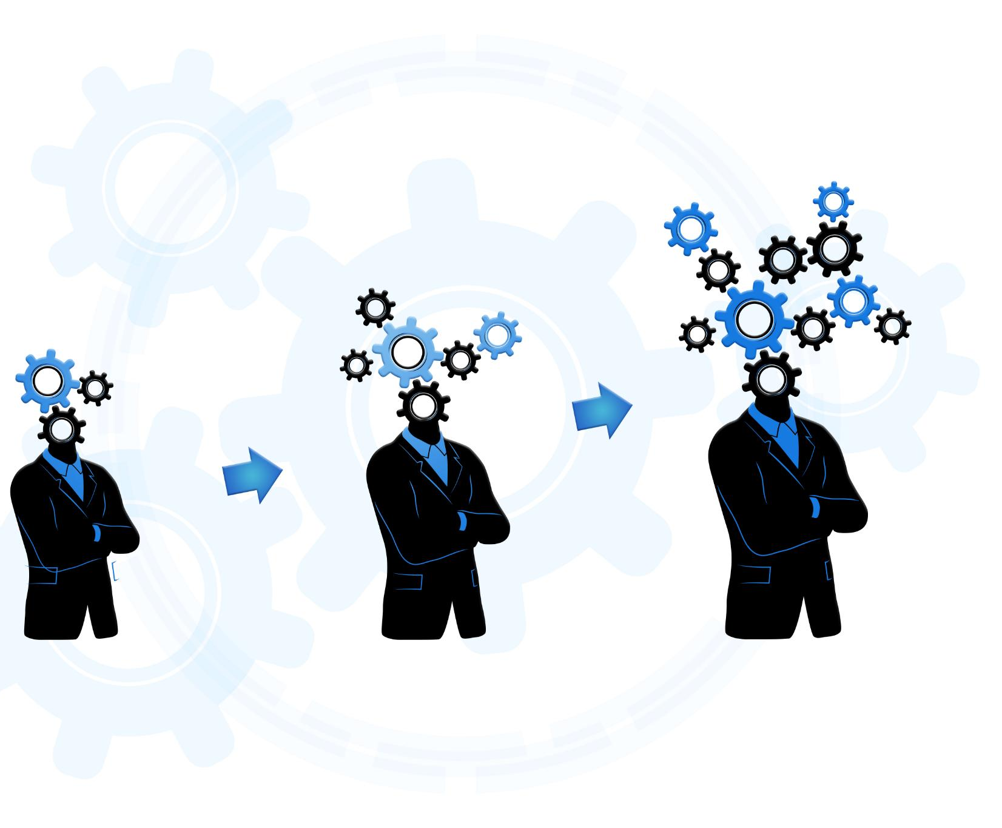
Decision-Making Processes and Negotiation Among Agents
Collaborative Decision-Making
Agents work together to make decisions that consider diverse goals and preferences.
Negotiation for Balanced Outcomes
Through negotiation, agents reconcile differences to achieve efficient and fair results.
Notes:
--- Agents engage in decision-making and negotiation to reconcile differing goals and preferences, ensuring efficient and balanced outcomes. Image source: Microsoft 365 content library

Slide 18

Negotiation Strategies for Resolving Preferences and Goals
Compromise Strategy
Compromise involves mutual concessions to resolve conflicts and find a middle ground between differing preferences.
Auction-Based Methods
Auction-based methods use bidding processes to efficiently allocate resources and align agent goals.
Game-Theoretic Approaches
Game theory models strategic interactions to predict outcomes and optimize negotiation strategies.
Notes:
--- Strategies include compromise, auction-based methods, and game-theoretic approaches to resolve conflicts and align agent objectives. Image source: Microsoft 365 content library

Slide 19

Applications of Multi-Agent Systems in Robotics, Finance, and Logistics
Cooperative Robotics
Multi-agent systems enable robots to work together effectively in tasks like exploration and manufacturing.
Automated Trading in Finance
Multi-agent systems power automated trading strategies optimizing financial market decisions.
Optimized Logistics
Multi-agent systems improve supply chain management by optimizing resource allocation and routing.
Notes:
--- Multi-agent systems are applied in diverse fields such as cooperative robotics, automated trading in finance, and optimized logistics and supply chain management. Image source: Microsoft 365 content library

Slide 20
Learning, Adaptation, and Agent Evolution Through Feedback
Continuous Learning
Agents constantly acquire knowledge from their environment to improve decision-making and skills.
Behavioral Adaptation
Agents modify their actions based on feedback to enhance their effectiveness in dynamic environments.
Evolution Over Time
Through iterative learning and feedback, agents evolve to become more efficient and capable.
Notes:
--- Agents continuously learn from their environment and feedback, adapting their behavior to enhance performance and evolve over time. Image source: Microsoft 365 content library

Slide 21

Course Conclusion: Mastering Multi-Agent System Fundamentals and Memory
Agent-Based Operating Systems
Understanding agent-based OS fundamentals is crucial for building efficient and adaptive multi-agent systems.
Memory Mechanisms
Memory models support intelligent behavior and coordination within multi-agent systems.
Advanced Multi-Agent Systems
Mastering fundamentals leads to creating intelligent, adaptive multi-agent systems for complex tasks.
Notes:
--- In summary, mastering the fundamentals of agent-based operating systems and their memory mechanisms enables the development of advanced, adaptive, and intelligent multi-agent systems. Image source: Microsoft 365 content library

Slide 22
Conclusion
Foundational Concepts
Understanding core principles is essential for building advanced intelligent systems.
Collaboration and Negotiation
Effective agent interaction drives improved decision-making and system performance.
Real-World Applications
Integrating intelligent systems into practical scenarios enhances technological evolution.
Notes:
The exploration of LLMs as operating systems with agent memory highlights the importance of foundational concepts, mechanisms, reasoning, collaboration, negotiation, and real-world applications. Together, these elements drive the evolution of intelligent multi-agent systems.

